Slide 1
C programming language – simple function
Fresher Learning Program
September, 2011

Slide 2
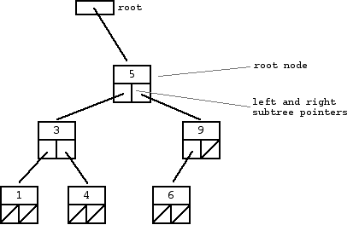
Data Structures
Linked List: A Struct data that has a pointer to another struct, so forth till the end of the list is NULL / loop (error if the list is not circular)
Binary Trees: A binary tree consists of a grouping of nodes. Each node has :
Data member
Left Node pointer (can be NULL)
Right Node pointer (can be NULL)
If the pointer is NULL, it is known as a leaf.

Slide 3
Simple C header file
Code
Comments
/* File name: myHello.h */
#include <stdio.h>
void myprint ()
{
printf (“Hello World\n”);
}
/* comments */
/* include information about standard library */
/*define a function myprint enclosed in braces*/
/* myprint calls library (cstdio) function printf to stream to stdout (console)
\n represents newline*/
Notes:
How and why we call printf from stdio.h ?

Slide 4
Simple C hello world modified from [5]
/* Filename : Hello.c */
#include “myHello.h”
/* Notice double quotes instead of #include <filename> */
int main () /* defines a function called main that receives no argument values */
{
myprint(); /* Call the function myprint defined earlier */
/* Blindly notify the execution environment
* that the program executed successfully*/
return 0;
}
Notes:
Unix return codes are usually 0 for success. You can view the status of the last program with the command “echo $?”

Slide 5
Datatypes in C [5]
There are only a few basic data types in C:
char a single byte, capable of holding one character in the local character set
int an integer, typically reflecting the natural size of integers on the host machine
float single-precision floating point
double double-precision floating point

Slide 6
GDB And DDD debugging
GDB is a CLI tool useful for pinpointing errors in code at runtime. For GDB refer to :
http://www.linuxforu.com/2011/11/gdb-logging-function-parameters-part-1/
http://www.linuxforu.com/2011/12/gdb-logging-function-parameters-part-2/
DDD: DDD serves as a graphical front-end for gdb, dbx (solaris), Perl, Python

Slide 7
References
Memory layout of a C program
http://book.chinaunix.net/special/ebook/addisonWesley/APUE2/0201433079/ch07lev1sec6.html
Memory layout of a C program http://www.cyberplusindia.com/blog/index.php/2008/10/16/memory-layout-for-c-programs-in-linux/
Static variables in C and C++:
http://stackoverflow.com/questions/5921920/difference-between-initialization-of-static-variables-in-c-and-c
The C Programming Language – Kerninghan & Ritchie

Slide 8
Thank You For Your Time

